Slide 1
AZURE PROJECT
NIKHILA P N
214401@ust-global.com

Slide 2
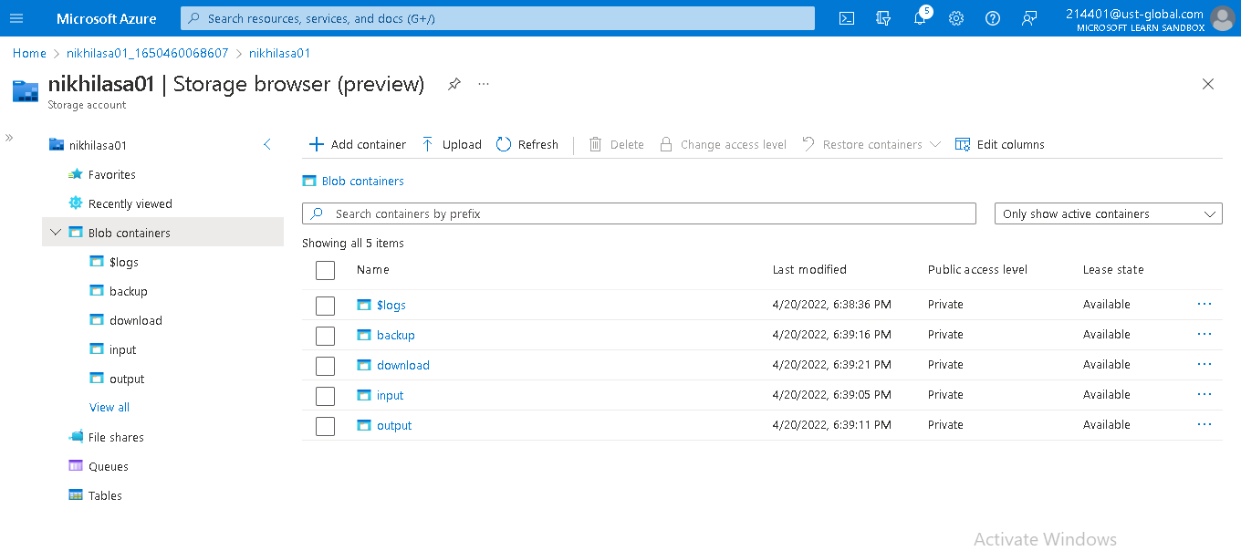
Storage Account in Azure with 4 Containers

Slide 3
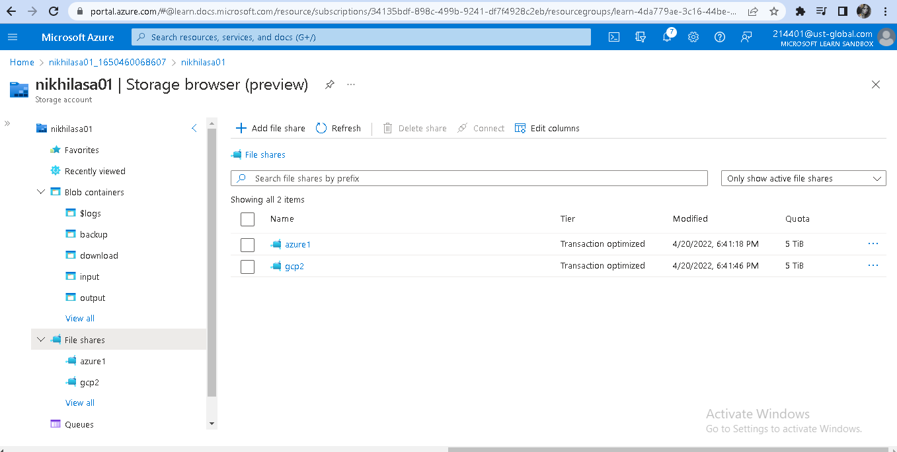
Fileshare with 2 Directories

Slide 4
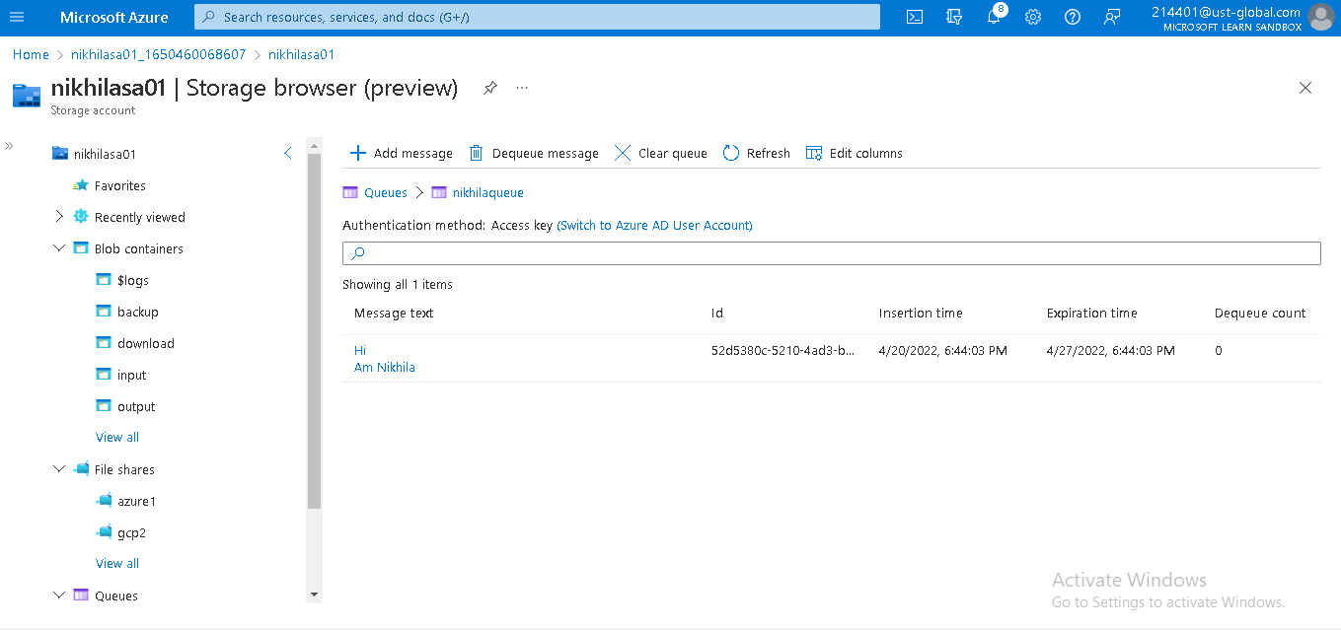
Message Queue with a message

Slide 5
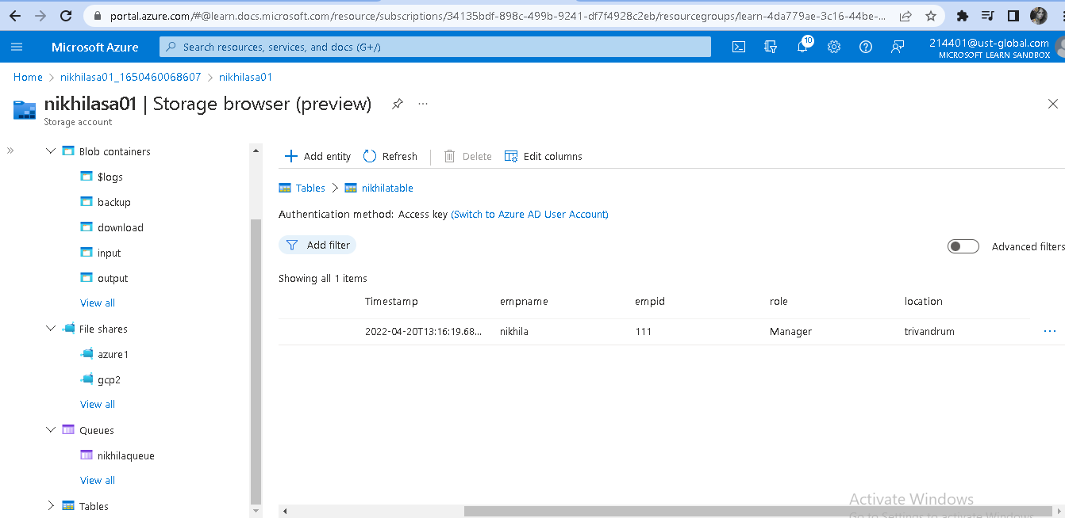
Table

Slide 6
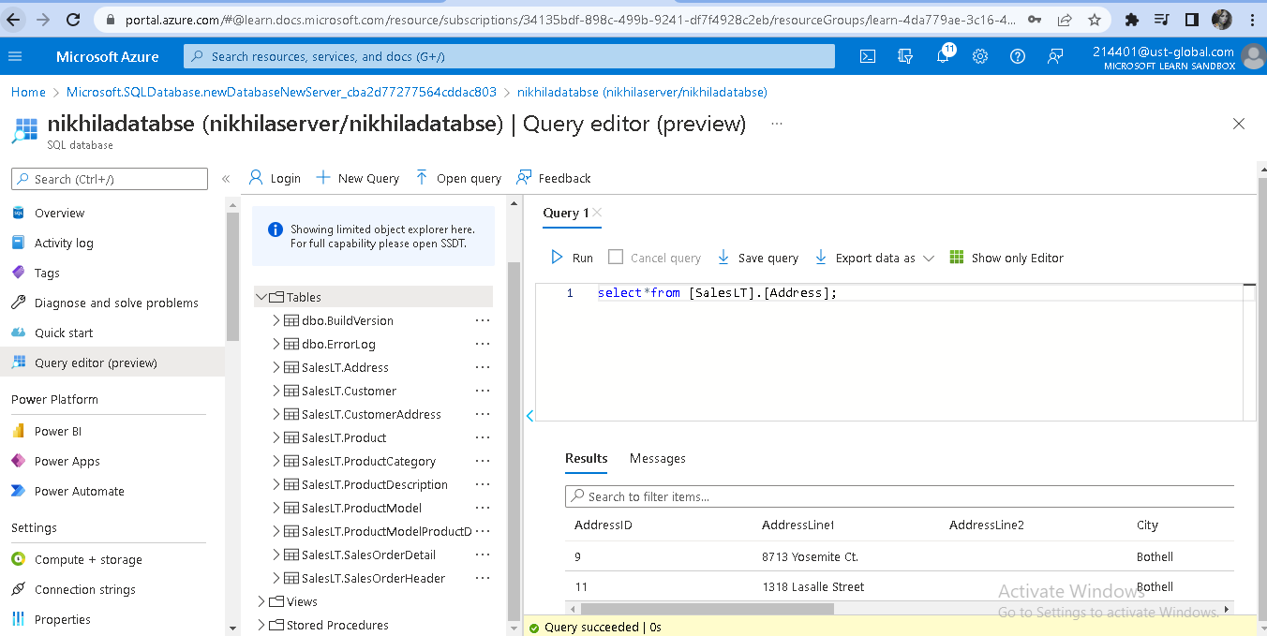
Sample Database with query

Slide 7
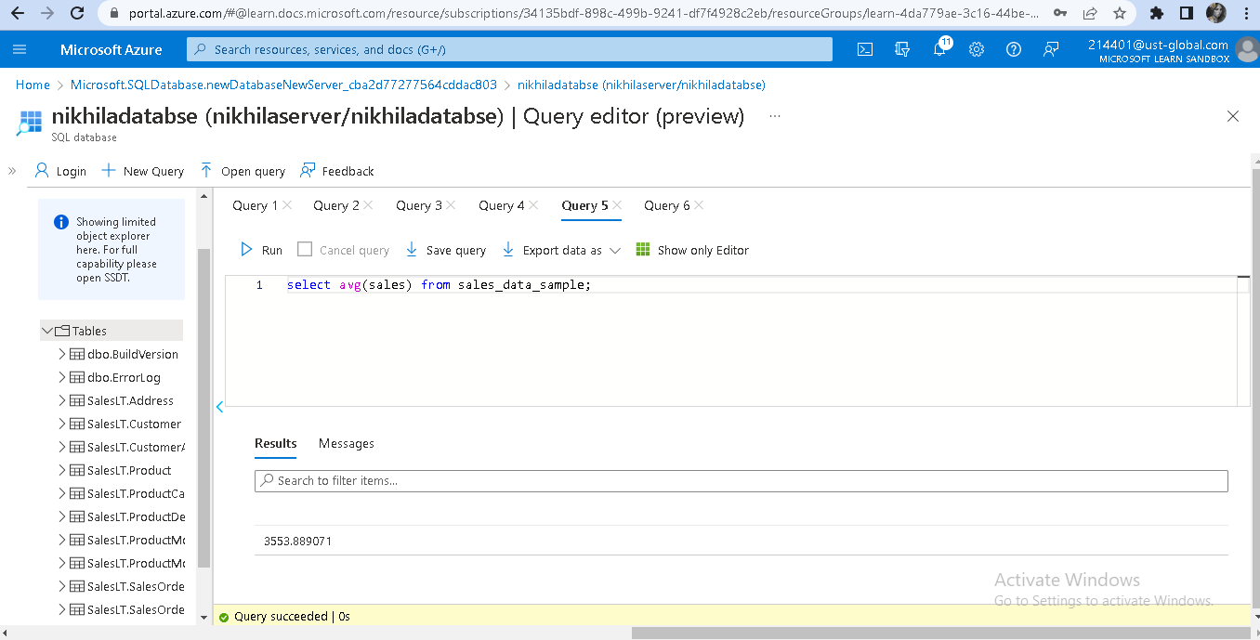
Sample Database with Dimensions and Fact Tables-To estimate the unit sales of retail goods

Slide 8
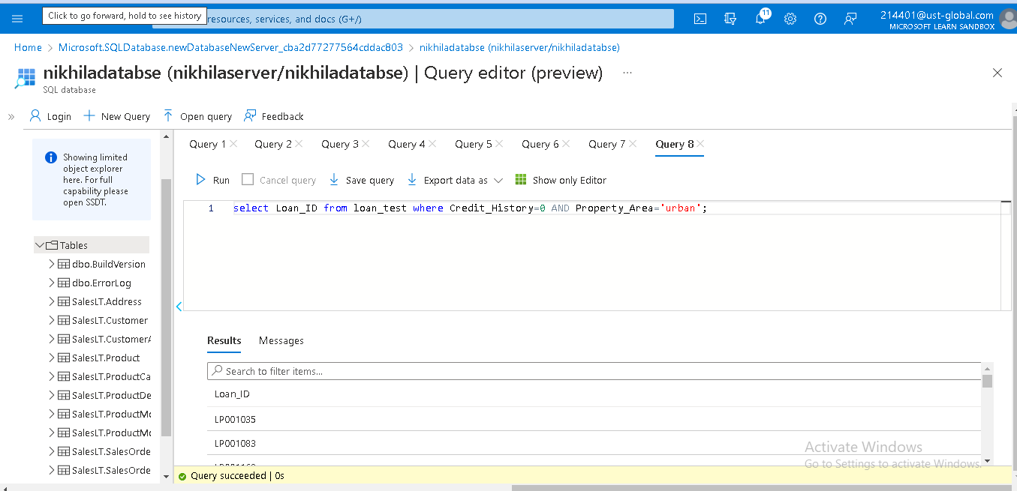
Sample Database with Dimensions and Fact Tables-Financial Need Programs for Consumer Loan Products

Slide 9
THANK YOU….

